Slide 1
Artificial Intelligence & Ethics
The advancement of a general Artificial Intelligence is necessary to further our understanding of self, the natural world around us, and the evolution of our species regardless of the ethical concerns surrounding Artificial Intelligence
Notes:
Intro, Read Thesis

Slide 2
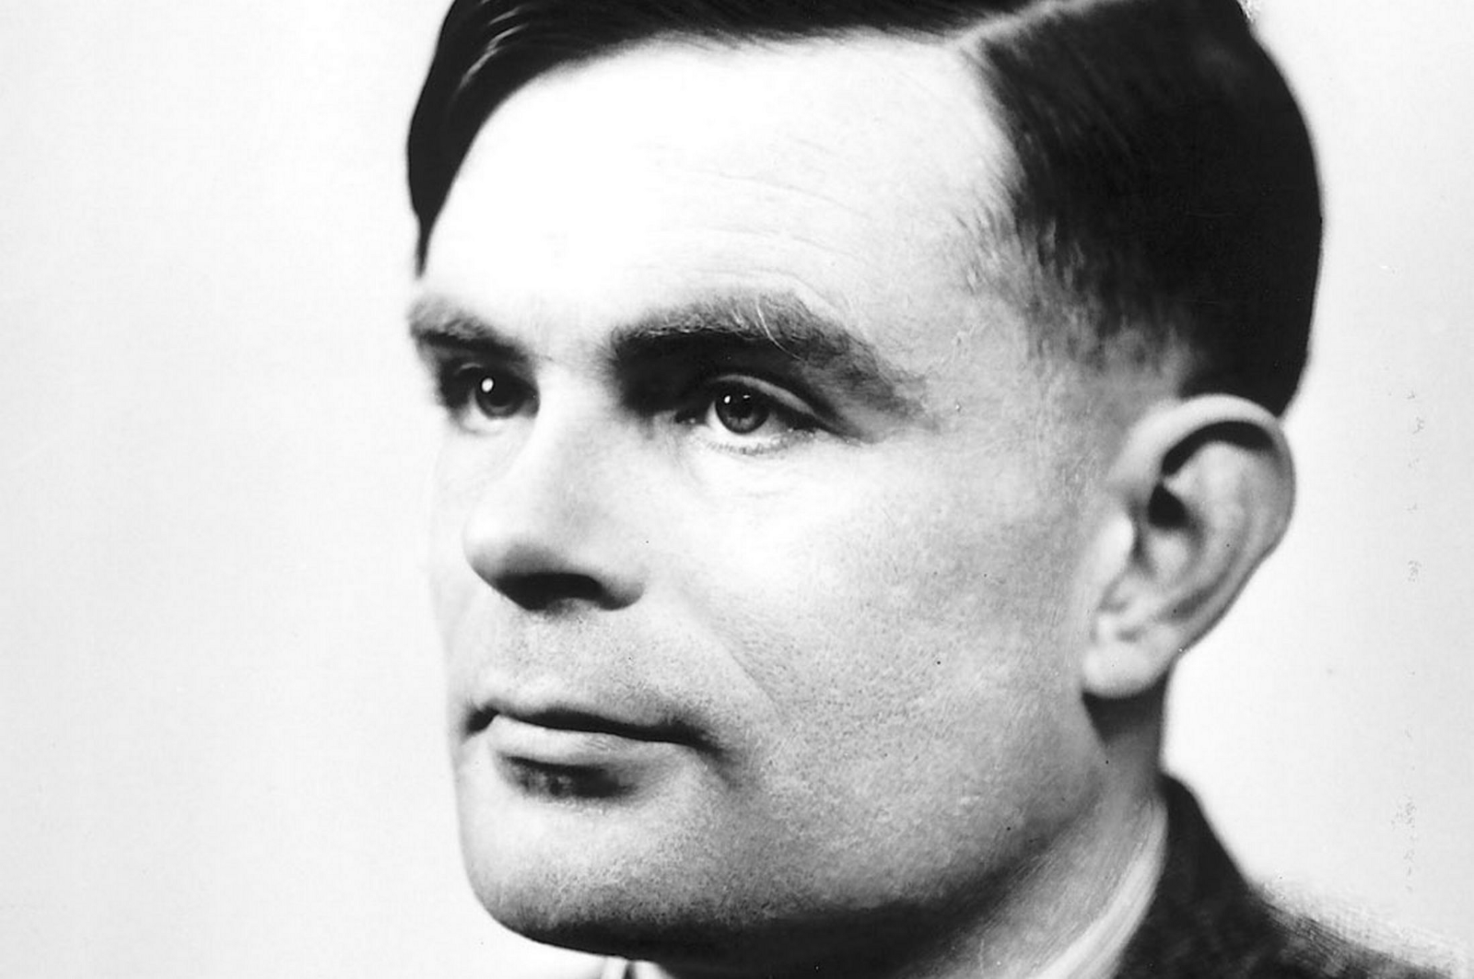
ALAN TURING 1912-1954
http://www.techweekeurope.co.uk/wp-content/uploads/2012/06/Alan-Turing-large.jpg
Notes:
Introduce Alan, Idea of Turing Test

Slide 3
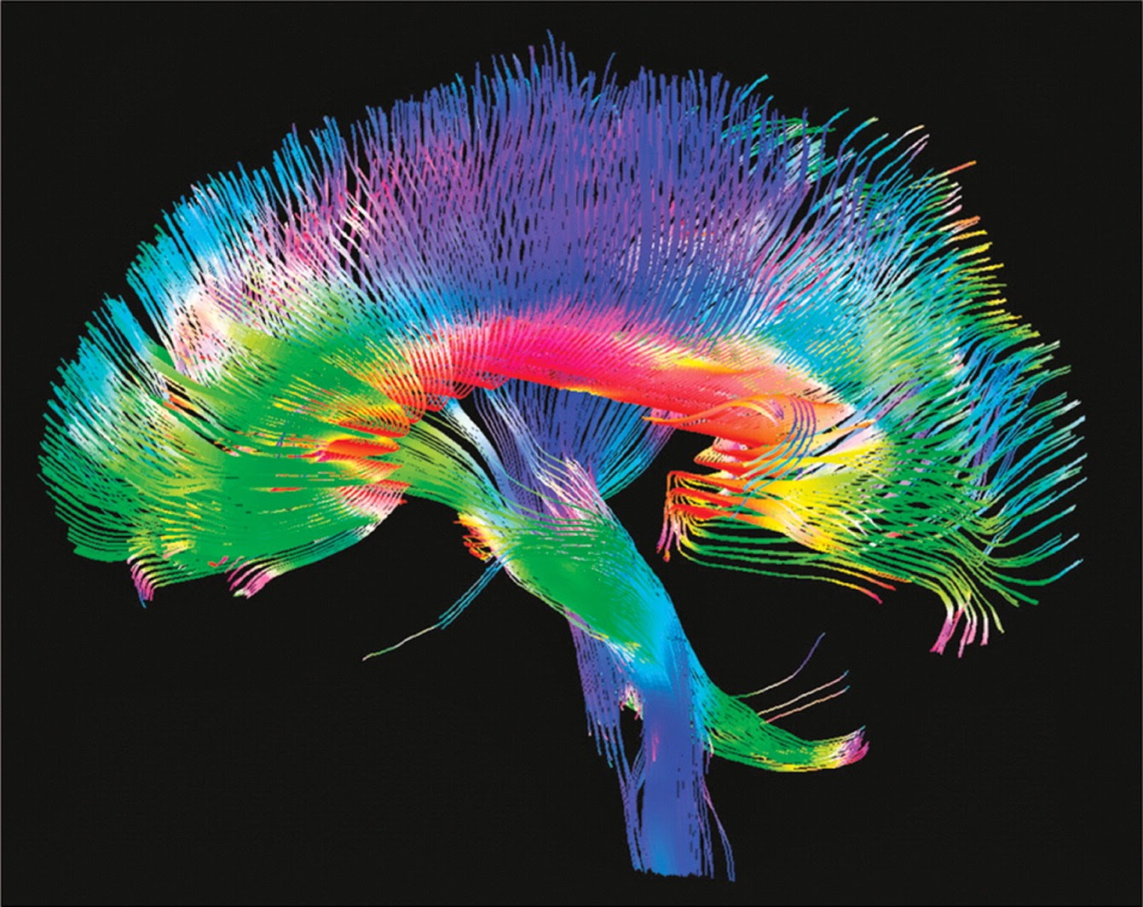
https://news.usc.edu/files/2015/03/brain2.jpeg
Notes:
Explain Brain connections

Slide 4
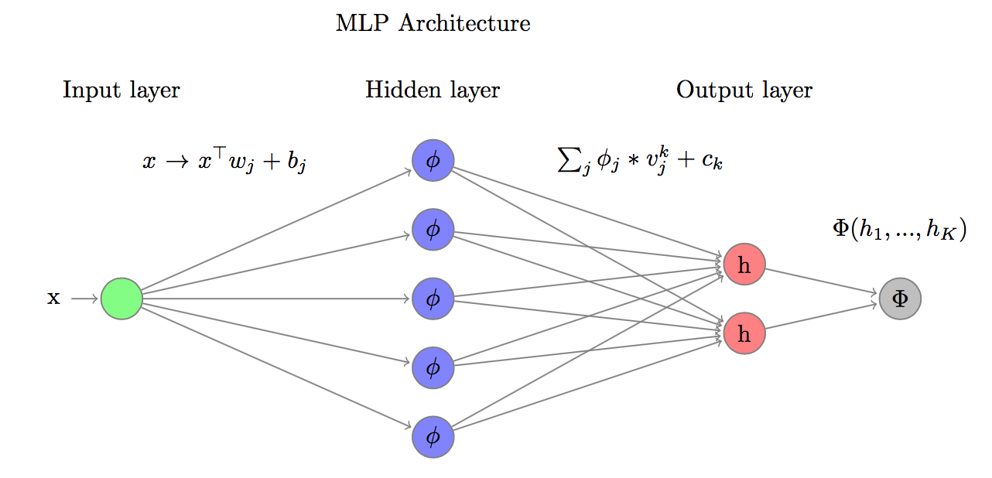
02
03
https://i.stack.imgur.com/4dujG.png
Notes:
Explain Machine Learning. What’s important about this?

Slide 5

https://spectatorau.imgix.net/content/uploads/2017/06/Contents_iceberg.jpg?auto=compress,enhance,format&crop=faces,entropy,edges&fit=crop&w=820&h=550

Slide 6

http://media1.s-nbcnews.com/i/MSNBC/Components/Slideshows/_production/ss-140707-south-sudan-famine/ss-140707-south-sudan-famine-01.jpg

Slide 7

https://static.businessinsider.com/image/53b0203becad04522b8877e8/image.jpg

Slide 8

http://www.dccomics.com/sites/default/files/GalleryComics_1920x1080_20150826_CYB_Cv2_55cceb0d8f1d31.28141728.jpg

Slide 9
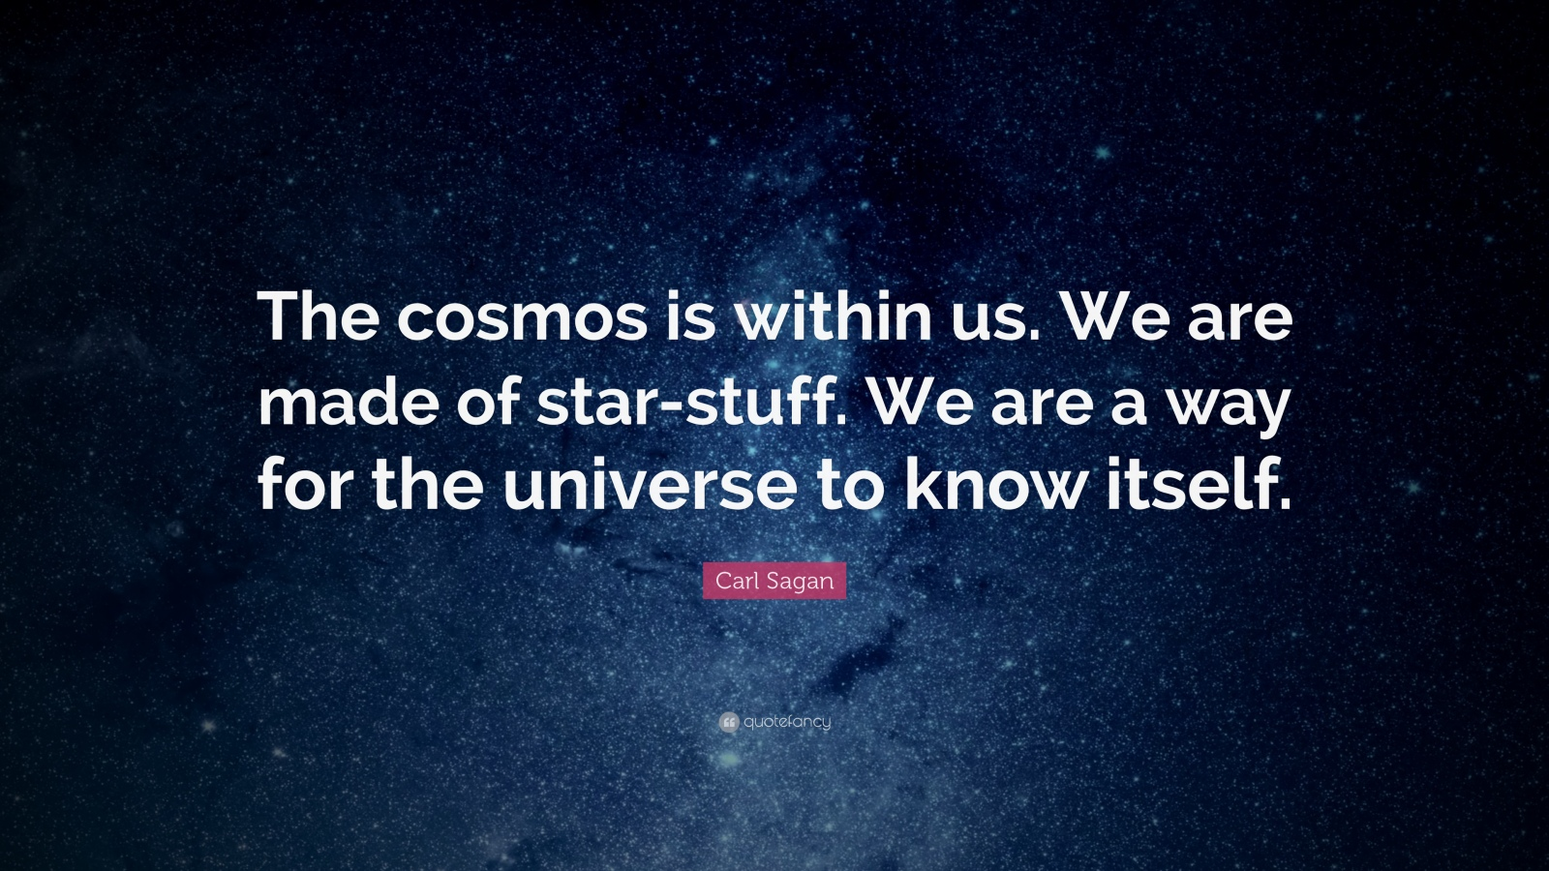
https://www.pinterest.co.uk/pin/524810162820375326/

Slide 10
Citations
1. Wallach, Wendell, and Colin Allen. “Moral machines: teaching robots right from wrong.” Oxford University Press, 2009. Retrieved Feb. 10th, 2018 from Albertsons Library.
2. Lynch, Gary. Granger, Richard. “Big Brain: The Origins and Future of Human Intelligence”. New York: Palgrave Macmillan (2008). Retrieved Mar. 2.
3. Patrick Henry Winston. “Artificial Intelligence: Third Edition” Addison-Wesley Publishing Co., 1992. Retrieved Mar. 18th, 2018 from Albertsons Library.

